Slide 1
Energy Management System
Andrew Cope, Jacob Lauzon, Donald MacIntyre, Ryan McLaughlin
Notes:
Jacob

Slide 2
Presentation Overview
Customer Needs
Engineering Specifications
Concept Selection
Top Level Design
Detailed System Diagrams
Bill of Materials
Risks
Testing
Questions
Notes:
Jacob

Slide 3
Needs Statement
Many homeowners and businesses are not aware of their power usage habits. This lack of awareness leads to potentially inefficient power usage. Existing products are either too expensive or do not include all functionality, such as the ability to remotely control, monitor, and manage power consumption. A system is needed to allow for monitoring and basic management of a home’s or business’s power usage for a reasonable price.
Notes:
Andrew

Slide 4
Needs & Marketing Requirements
The system shall accurately monitor power consumption.
The system shall allow for control of whether a single gang of outlets is powered.
The system shall allow for a schedule to turn gangs on and off automatically.
The system shall be safe.
The system shall provide intuitive visual representations of usage data.
The system shall have low cost in comparison to competitive products.
The system shall be easy to install by a professional.
The system shall have an easy to use interface.
The system shall be of reasonable size in comparison to existing systems.
The system shall consume minimal power.
The system shall communicate usage data and commands between outlets and the main module.
Notes:
Andrew

Slide 5
Engineering Specifications
Marketing Requirements |  | Engineering Requirement | Justification
6 | A | Production cost shall not exceed $200 for the main unit and $50 for each outlet module. | This is based upon analysis of a competitive market and current design requirements.
7 | B | Installation time of an outlet module within an electrical box shall not exceed 30 minutes during typical installation. | Using a professional electrician, the outlets can be installed within this time frame.
4 | C | The system shall survive a 2500V impulse voltage per IEC-60664-1. | This will prevent devices from being damaged due to transient spikes on the power line.
4 | D | Control circuits shall be isolated from power line by 1250V RMS minimum. | Electrical isolation is required by safety agencies for equipment connected to the AC power line.
Notes:
Ryan

Slide 6
Engineering Specifications
Marketing Requirements |  | Engineering Requirement | Justification
1 | E | The control unit shall be capable of varying the load power from 0 to full power for resistive loads. | Dimming function allows reducing load power consumed for energy savings. This is only applicable for purely resistive loads, (e.g., lightbulbs, heaters, etc.).
1 | F | The system shall measure power consumption with an accuracy of ± 10 % | This will allow the system to measure usage accurately enough for the typical user.
1,2,3,5,8 | G | A web interface or web application shall allow the monitoring and management of the system. | This will allow for user to be able to manage the system and perform various tasks associated with the system.
Notes:
Ryan

Slide 7
Engineering Specifications
Marketing Requirements |  | Engineering Requirement | Justification
8 | H | The user shall be able to understand complete system functionality within an hour. | Analysis shows that an intuitive interface should require minimal time to operate.
4 | I | The system shall use only UL recognized components. | Safety agency approvals will be required to sell product commercially.
9 | J | The production system shall be able to fit into current standard electrical outlets. | To be fully integrated and competitive, the system must be able to replace current outlets.
Notes:
Ryan

Slide 8
Engineering Specifications
Marketing Requirements |  | Engineering Requirement | Justification
10 | K | The system shall have greater than 95% efficiency at maximum rated load. | To achieve energy savings and to avoid excessive heating of the wall units.
2,3 | L | Wall units shall be identifiable. | This allows the system to know what information is coming from what wall unit and to provide individual control.
11 | M | All modules shall transmit at a BPS rate sufficient to relay commands and usage data at the chosen sampling frequency. | In order to have reliable communication, the modules must have an adequate minimum communication rate.
Notes:
Ryan

Slide 9
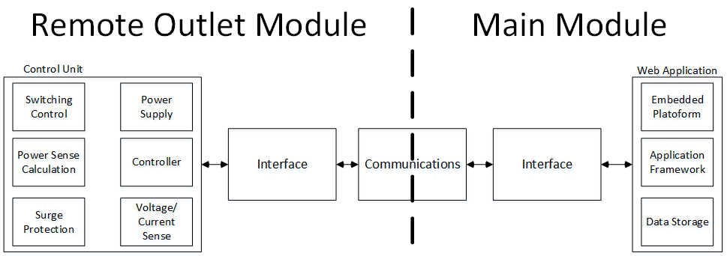
Top Level Diagram
Notes:
Donald

Slide 10
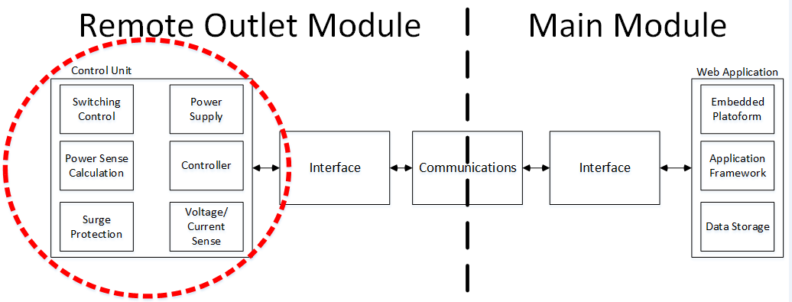
Control Unit
Notes:
Donald

Slide 11
Remote Outlet Module Concepts
Switching Control
Triac driven by MOC3063M, an optically coupled (electrically isolated) driver
Power Sense Calculation
Implementation of root-mean squared (RMS) algorithm in chosen controller
Surge Protection
MOV used to dissipate excess energy in a surge situation
Power Supply
Recom Switch Mode Power Supply
Controller
De-0 Nano board. Lots of GPIO to interface, plus a onboard 8 channel ADC.
Voltage Sense
Optically Isolated Amplifier using sigma delta modulation
Current Sense
Hall effect current sensor
Notes:
donald

Slide 12
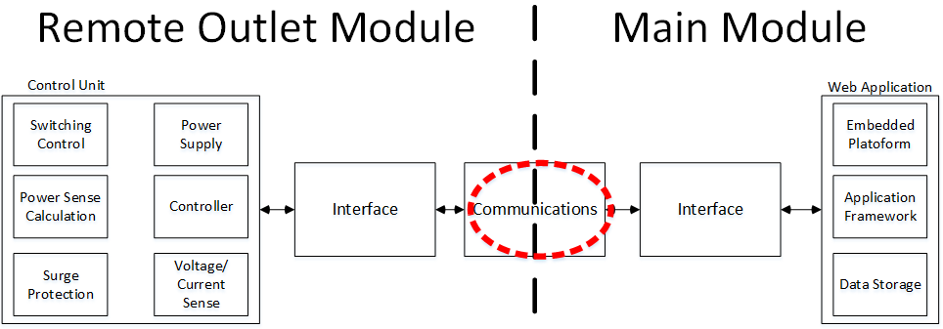
PLC Concepts
Notes:
ryan

Slide 13
PLC Selection
PLC Chosen for communication to permeate through walls & obstacles
As a mature technology, most available PLC chips utilize high enough frequencies to avoid interference, and most come with collision handling – The main concern is data rate.
Wanted potential for near real time measurements (Transmit every .1 seconds)
Wanted to support 200 outlets (Minimum 8-bit ID)
Wanted power measurements accurate with 14 bits
𝐵 > 𝑀_{O} ∗ (𝑃[𝑏𝑖𝑡𝑠] + 𝐷[𝑏𝑖𝑡𝑠]) ∗ (𝐹𝑠)
B > 44000 bits/second

Slide 14
PLC Options
Part | Packet Bits | Provided Data Rate | Collision Provisions | Interface
CY8CPLC10 | 56 | 2400 | Yes | I2C
CY8CPLC20 | 56 | 2400 | Yes | I2C, UART
ST7540 | 0 | 4800 | No | UART,SPI
ST7570 | 112-336 | 2400 | Yes | UART
ST7590 |  | 128000 | Yes | UART,SPI
MAX2992 |  | 300000 | Yes | UART,SPI
ATSAM4CP16B |  | 128000 | Yes | UART,SPI
TDA5051A | 0 | 1200 | no | Digital

Slide 15
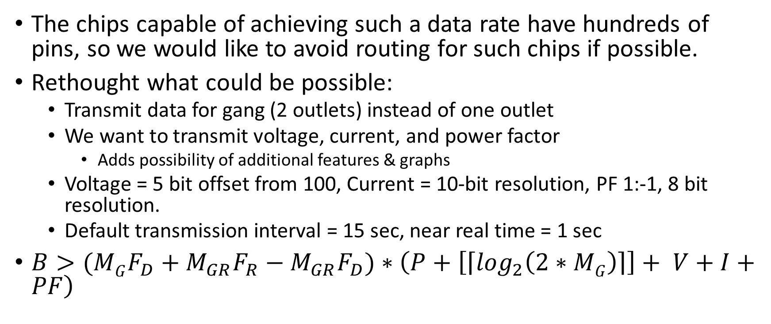
PLC Rethought
The chips capable of achieving such a data rate have hundreds of pins, so we would like to avoid routing for such chips if possible.
Rethought what could be possible:
Transmit data for gang (2 outlets) instead of one outlet
We want to transmit voltage, current, and power factor
Adds possibility of additional features & graphs
Voltage = 5 bit offset from 100, Current = 10-bit resolution, PF 1:-1, 8 bit resolution.
Default transmission interval = 15 sec, near real time = 1 sec
$B>(MGF_{D}+M_{GR}F_{R}−M_{GR}F_{D})∗\left(P+\left[\left\lceil \log_{2}\left(2∗MG\right)\right\rceil \right]+ V+I+PF\right)$

Slide 16
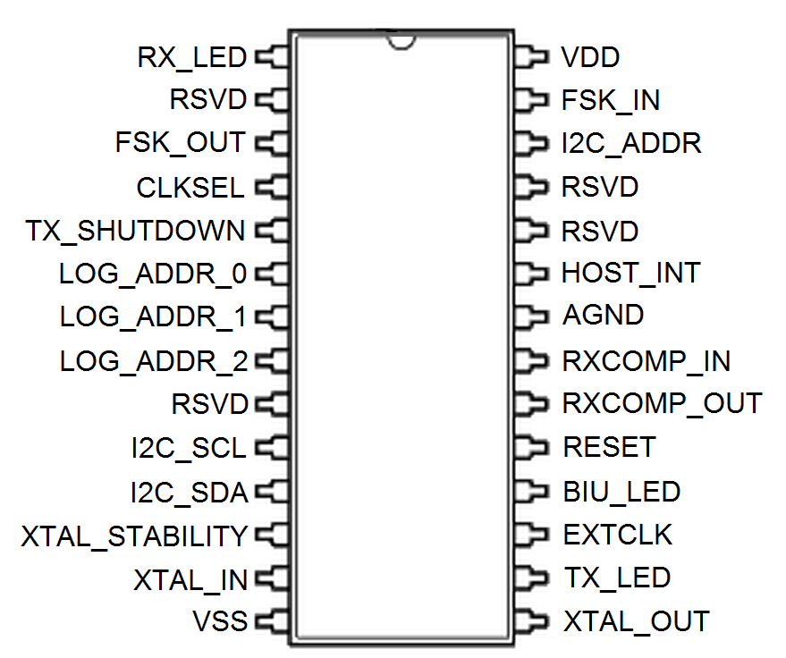
PLC Rethought
Assuming 100 Gangs, and at most 5 Gangs transmitting at real time, as well as the reductions made here, then the minimum is
340 bps
Using the desired Cypress chips, with P=56 bits, then
896 bps
This is well below the provided 2400 bps, but if it is exceeded, then it is possible to reduce the number of outlets, as a typical home does not have 200.
Further, the default rate could be modified.
Options narrowed to Cypress CY8CPLC10 and CY8CPLC20 (PSoC version of CY8CPLC10).

Slide 17
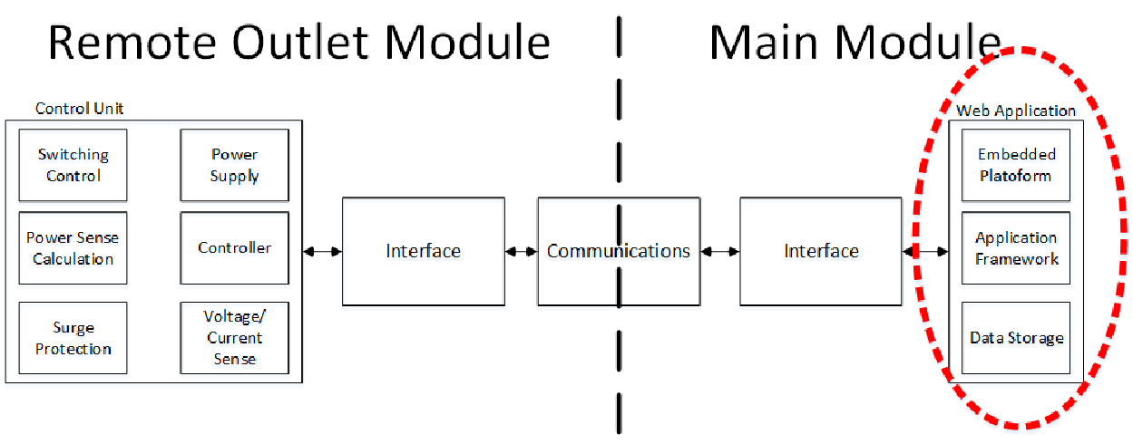
Main Module
Notes:
andrew

Slide 18
Data Storage
Data needs to be stored in order for it to be presented to the user
Can be stored in multiple ways:
One single file
Database
Memory
Notes:
andrew

Slide 19
Why Choose a Database?
Queries: being able to search through all of the data
Large data sets handled easily
Easier to manage data (DBMS)
ACID (Atomicity, Consistency, Isolation, Durability) Compliance

Slide 20
Database Management System (DBMS)
Creating, Updating, Querying, Administrating Databased
Popular DBMSs:
Microsoft SQL Server
MySQL
PostgreSQL
SQLite

Slide 21
Microsoft SQL Server
Developed by Microsoft
Windows Server OS only
Commercial license
ACID Compliant
Smaller number of programming languages supported
Multiple locking techniques, based on current transaction

Slide 22
MySQL
Developed by Oracle
Available on all operating systems
GPL open-source commercial license
ACID compliant (depending on storage engine)
Many programming languages supported
Table-level or row-level locking (depending on storage engine)

Slide 23
PostgreSQL
Developed by PostgreSQL
Available on all operating systems
BSD open-source license
ACID compliant
Fewer programming languages supported than MySQL
Both locking mechanisms supported

Slide 24
SQLite
Developed by Richard Hipp (originally)
Available on all operating systems
Open source through public domain license
ACID Compliant
Many programming languages supported
Variation of table-level locking supported

Slide 25
MySQL Storage Engine
Memory
Data is stored in memory, then flushed to disk once enough changes made
Quicker access times, but risk of data loss during power outage
MyISAM
Not ACID Compliant
Table-level locking (good for read heavy applications)
InnoDB
ACID Compliant
Row-level locking (good for write heavy applications)

Slide 26
Embedded Platform
Product | Raaspberry Pi 2 Model B+ | BeagleBone Black Rev. C
Price | $35 | $55
Size | 3.370" x 2.224" | 3.4" x 2.15"
Processor | Broadcom BCM2836 | AM3358BZCZ100
Cores | 4 | 1
Clock Speed | 900 MHz | 1 GHz
RAM | 1 GB | 512 MB
Onbaord Flash | None | 4 GB
External Storage | microSD | microSD
Operating Voltage | 5V | 5V
Power | 230 - 800 mA | 210 - 460 mA
Digital GPIO | 40 | 65
Analog Inputs | None | 7
I2C | Yes | Yes
SPI | Yes | Yes
Ethernet | 10/100 RJ45 | 10/100 RJ45
USB | 4 | 1
Video Out | HDMI | micro HDMI
Chose the Raspberry Pi 2
Cheaper
More memory
Similar power consumption
Ease of use
Runs full OS
Uses Python natively
Notes:
jacob

Slide 27
Language/Framework
HTML/CSS/PHP
Easy to set up
Lightweight
Django (Python)
Completely Python based
Fairly Lightweight
Vaadin Framework (Java)
Heaviest
Very powerful
Familiarity with framework and Java
Originally chose Django
Native Python
Low memory usage
Changed to Vaadin/Java
More powerful
Familiarity

Slide 28
Hosting
On-Device Hosting
Hosting both the MySQL database and web application directly on the Pi
Easy access from local network but only local network
Harder to manage (updates)
Less secure
Central Server
Databases and application hosted from another location
Easy to update
Easier to secure
Access from any network
Managing a datacenter is a huge task
Chose On-Device Hosting for now
Easier for a prototype
Don’t need functionality of a central server yet

Slide 29
Remote Outlet Top Level Diagram
Notes:
donald

Slide 30
Remote Outlet Hardware Schematic Connectors and AC to DC Supply
VCC3P3 – 3.3V input power from FPGA
POR – Power on Reset, active high to FPGA
Triac_drive – active high to turn on load
Vsense – 0-3.3V proportional to load voltage
Isense – 0-3.3V proportional to load current
TB1 – input power
TB2 – output to load
Power Supply 120 VAC to 5VDC at 1W, 1000uF cap to minimize output ripple

Slide 31
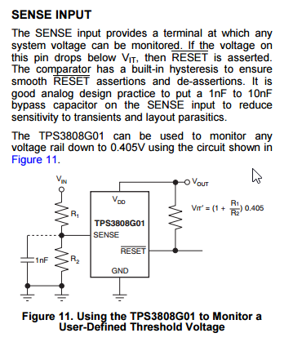
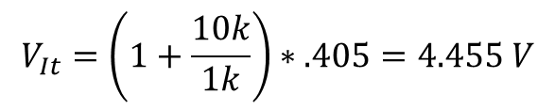
Remote Outlet Hardware Schematic Power on Reset (POR)
U1 – TPS3808G01, user-defined threshold voltage monitor
$$V_{It}=\left(1+\frac{10k}{1k}\right)∗.405=4.455 V$$

Slide 32
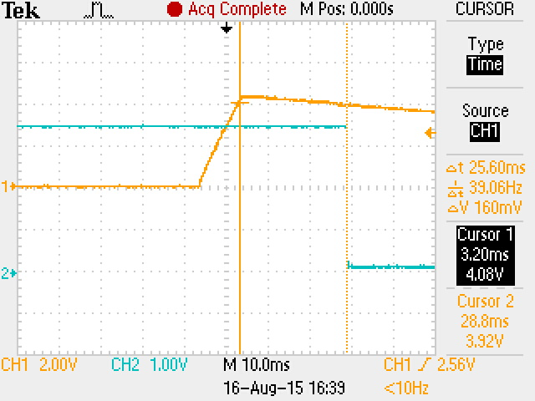
POR Hardware Results
Channel 1 – 5VDC Bus during power on event
Channel 2 – POR circuitry output
Delay between valid 5V DC and POR output about 25 ms as expected per datasheet

Slide 33
Remote Outlet Hardware Schematic Current Sense
Block measures current through the load and provides a proportional voltage corresponding to sensed current.
Voltage output centered around 1.65V (0A) and has resolution of 67 mV per A. Range is -20A to 20A
Applied current flowing through this copper conduction path generates a magnetic field which is sensed by the integrated Hall IC and converted into a proportional voltage.

Slide 34
Current Sense Test Results
Test Results
Current (A) | Voltage (V)
10 | 2.337
5 | 2.005
2 | 1.809
1 | 1.742
0 | 1.68
-1 | 1.614
-2 | 1.548
-5 | 1.351
-10 | 1.02
Known amount of current was driven into current sense IC.
Results show a voltage of 1.68V at 0A with a sensitivity of 65.7 mV

Slide 35
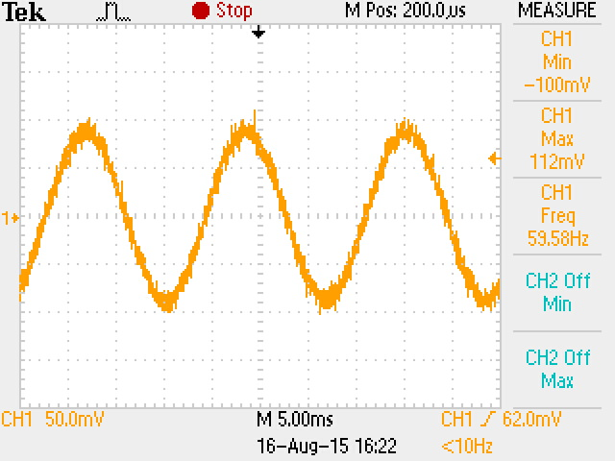
Current Sense Hardware Results
Current Sense Output with 120 ohm resistive load
Expected current is 1.414 A
Waveform shows AC coupled output of current sense circuit
Measured value was 1.4626A
Error of 3.44% assuming resistance value was exactly 120 ohms and line voltage was exactly 120 VRMS

Slide 36
Remote Outlet Hardware Schematic Voltage Sense
Block provides a proportional analog voltage relative to the line voltage
Stage one before op-amp scales and shifts voltage such that 2V corresponds to 200V and 0V corresponds to -200V
(U6) Amplifier provides isolation and has a gain of 1
Differential amplifier has a passband gain of 1.5 and rejects high frequency noise
$$V_{OUT}=\left(0.0049645V_{AC}+0.992\right)∗1.5$$

Slide 37
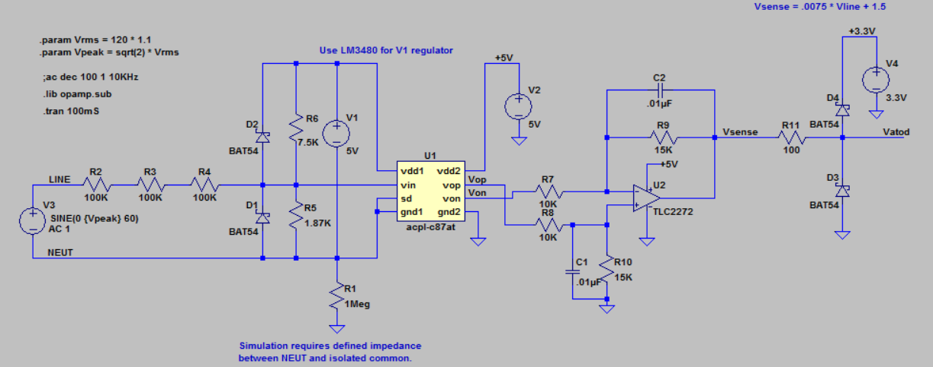
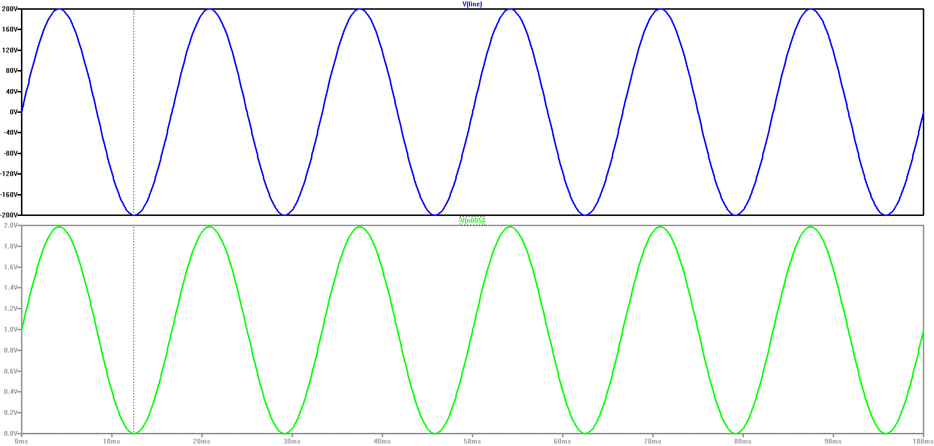
LT Spice Simulations
Top waveform – AC in ranging from 200V to -200V at 60 Hz
Bottom waveform – output waveform ranging from 2V to 0V
$$V_{OUT}=\left(0.0049645V_{AC}+0.992\right)∗1.5$$

Slide 38
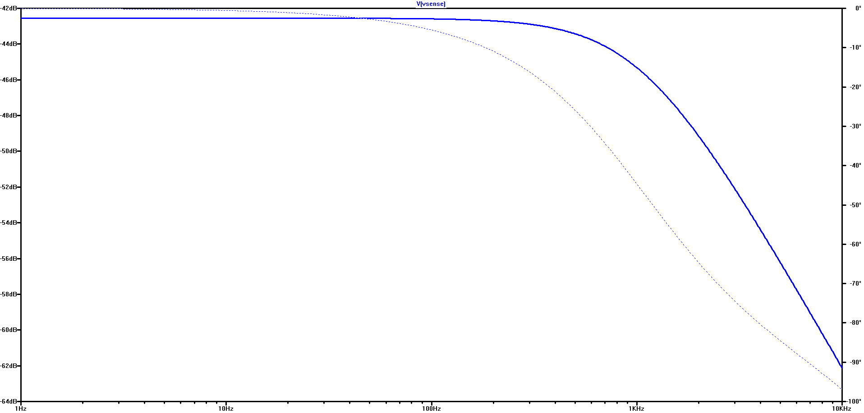
Frequency Response
At 60 Hz, passband gain is -42.8 dB, phase shift of -3.306
Cutoff frequency of about 1 kHz

Slide 39
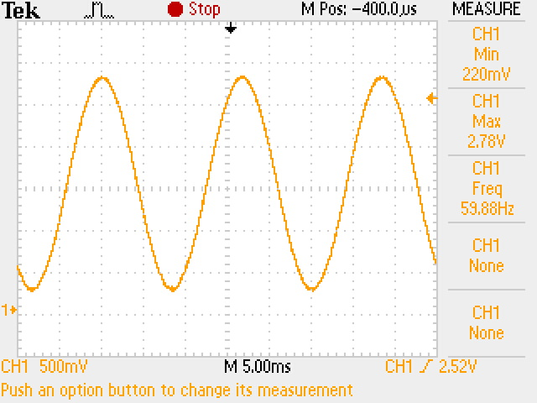
Voltage Sense Hardware Results
$$V_{OUT}=\left(0.0049645V_{AC}+0.992\right)∗1.5$$
Voltage output for 60Hz 120V RMS input
Expected Maximum Vout = 2.715
Actual Maximum Vout = 2.78
Expected Minimum Vout = 224 mV
Actual Minimum Vout = 220 mV

Slide 40
Remote Outlet Hardware Schematic Line 5V Generation
Need to generate a 5VDC voltage referenced to neutral for voltage sense amplifier.
5V reference used to power hot side of isolation amplifier, and also as a reference to center line voltage around 1 V

Slide 41
Remote Outlet Hardware Schematic Switching Contol
Provides a means for controller to switch the power to the load ON and OFF
Triac is turned on by driving triac_drive input high, selected triac driver MOC3043M provides zero crossing detection, preventing need for multiple fire pulses at every zero crossing

Slide 42
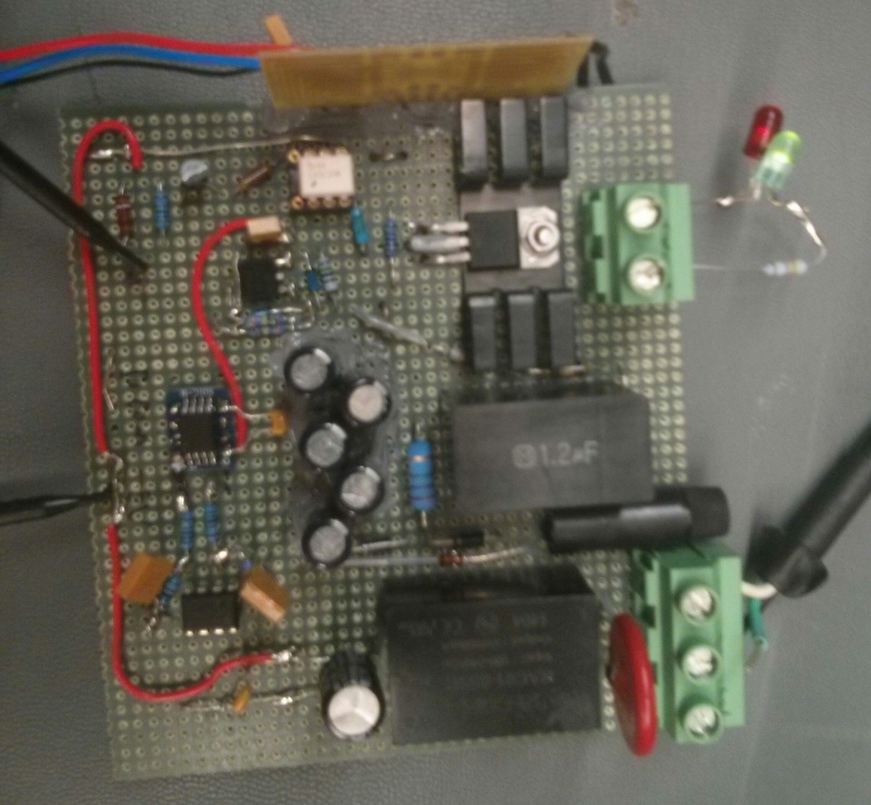
Remote Outlet Hardware Prototype
Load Switch/ TRIAC
Load Current Sense
Load
Cap coupled DC supply
Isolated TRIAC Drive
AC Input
Isolated Voltage Sense
AC-DC Isolated Supply

Slide 43
Remote Outlet Firmware Design

Slide 44
Remote Outlet Firmware Design

Slide 45
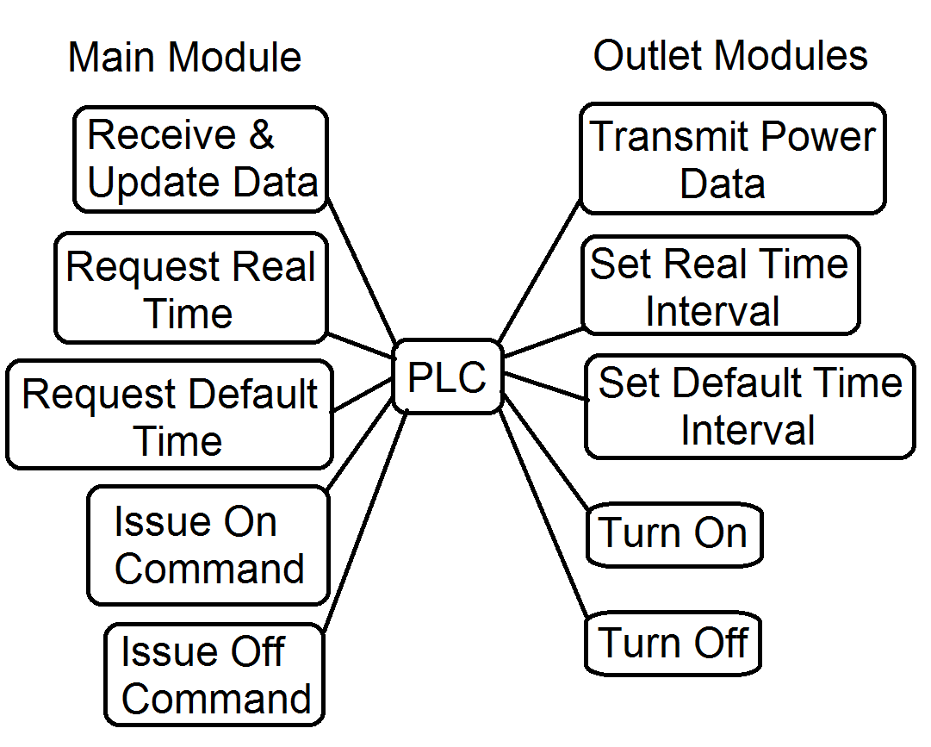
PLC Design
Given our concept of what will be communicated, the actions and commands are shown on the right.
The CY8CPLC10 and CY8CPLC20 both need various hardware components to actually operate. Fortunately, both have development kits detailing the amplifiers, frequency modulators, power line coupling, power supply, etc. in the form of schematics.
The following schematics are included from the CY3272 Evaluation Kit Guide.
Notes:
Ryan

Slide 46
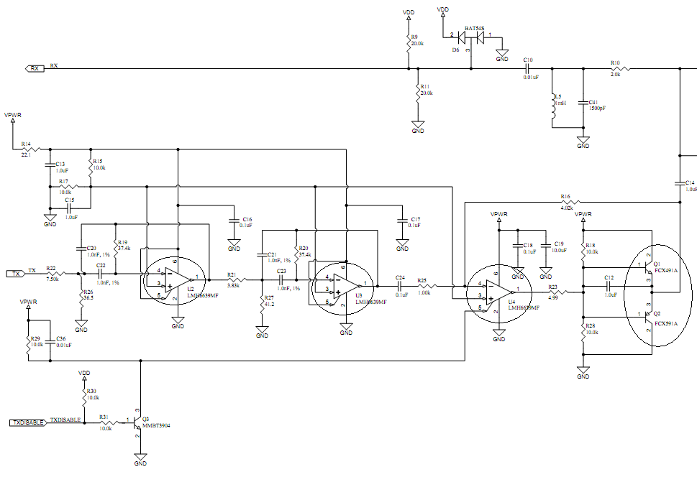
PLC Amplifier Schematic
LC Bandpass Receive Filter
To Line Coupling Transformer
Transmit Power Amplifier
Active Bandpass Filter
Notes:
Ryan

Slide 47
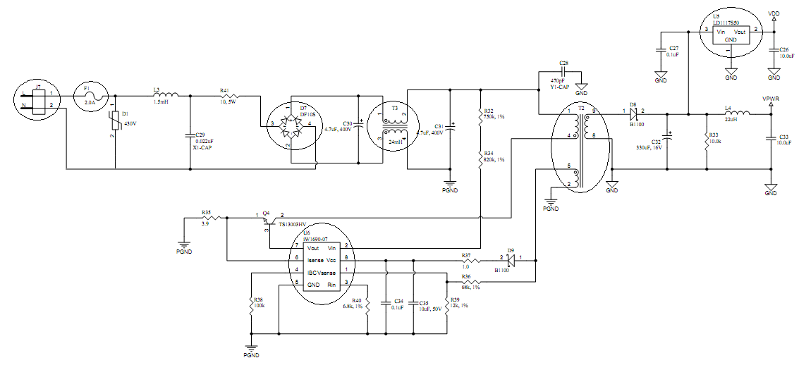
PLC Power Supply
Output Rectifier and Filter
Full Wave Rectifier
Common Mode Choke
High Frequency Transformer
Switch Mode Supply

Slide 48
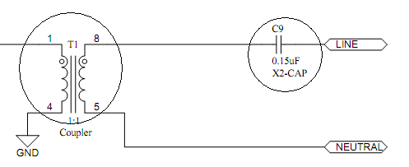
PLC Coupling

Slide 49
PLC Final Selection
Fortunately for our team, we were actually provided 2 dev. Boards for the CY8CPLC20, which cemented the CY8CPLC20 as our choice device.
Eliminates the need for us to manually implement each of the prior schematics, yet we know they are and could utilize them in production.
Should shorten the development time for utilization of the PLC
Concerns:
One board is non-operational, and must be replaced or repaired.
Utilizing an unfamiliar PSoC, potentially unknown development time.
There appear to be a good number of samples, and I was able to get the first board transmitting in under 10 minutes.

Slide 50
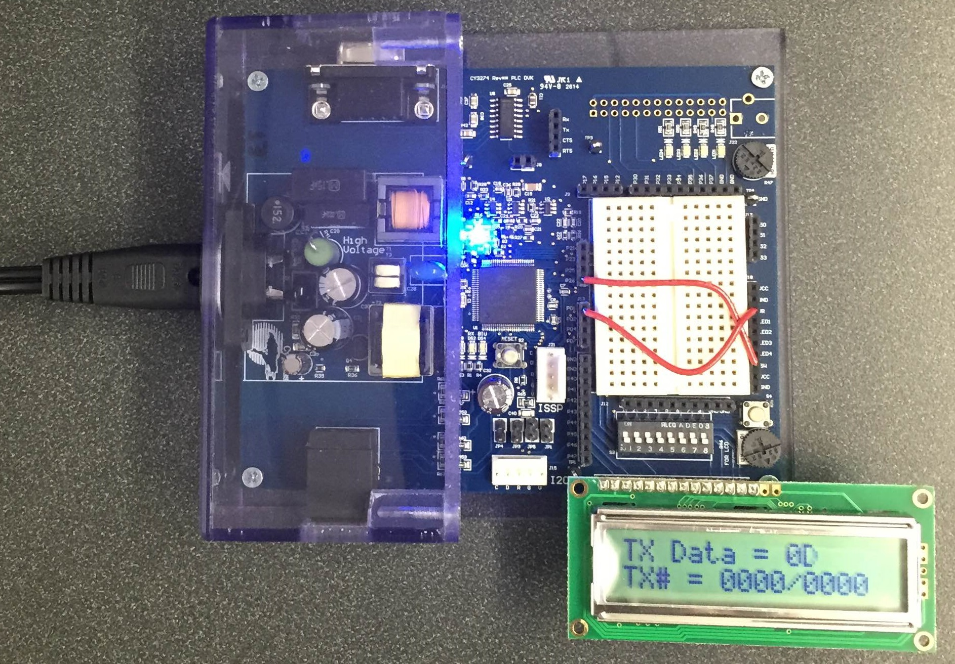
PLC Single Board Demonstration

Slide 51
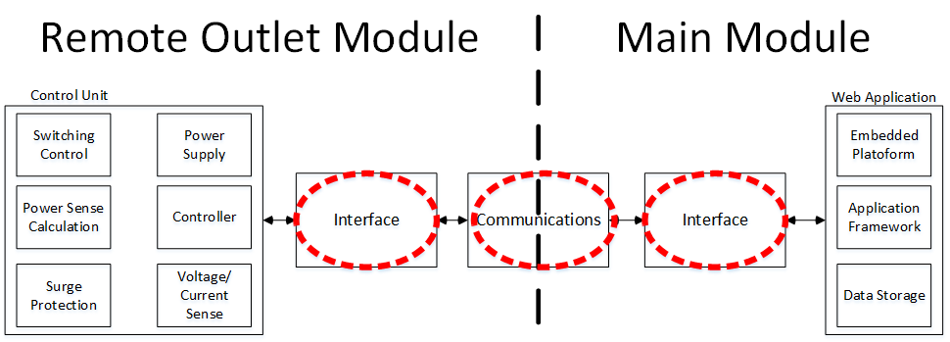
PLC Dev Board
Notes:
Ryan

Slide 52
Database Overview
Outlet Table
Stores essential information about each outlet module
GroupLines Table
Stores which outlet belongs to which group
Group Table
Stores information about each group
Measurement Table
Stores the measurements received by the outlet module
Settings / Schedule / User Tables
Store information primarily used by the web app
Notes:
Andrew

Slide 53
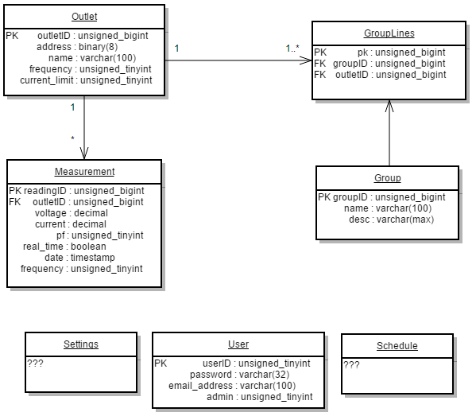
Database UML Diagram

Slide 54
Expected Row/Table Sizes
Table Name | Est. Size Per Row | Est. Entries Per Table | Est. Size Per Table
Outlet | 119 B | 50 – 100 | 6 – 11 KB
GroupLines | 24 B | 50 – 100 | 1 – 2 KB
Group* | 365 B | ~25 | ~9 KB
Measurement* | 31 B | 5,760 * # Outlets Per Day | 8.5 – 17 MB Per Day
Settings | ??? | < 20 | 1 – 5 KB
Schedule | ??? | < 50 | 1 – 10 KB
User | 136 B | < 10 | 1- 2 KB

Slide 55
Data Compression
Consumers don’t need to know power consumption per minute from one month ago
Take the measurements from 30-31 days ago (or sooner)
Average some number of measurements into 1 measurement
4 Measurements @ 15 seconds = 1 Measurement @ 1 minute
240 Measurements @ 15 seconds = 1 Measurement @ 1 hour
5,760 Measurements @ 15 seconds = 1 Measurement @ 1 day
Averaging keeps the data the same while saving disk space

Slide 56
Data Compression
# Outlet Modules | Original Size / Day | Original Size / Year | 4 -> 1 Size / Day | 4 -> 1 Size / Year | 240 -> 1 Size / Day | 240 -> 1 Size / Year
1 | 175 KB | 62 MB | 44 KB | 15 MB | 744 B | 265 KB
10 | 1.7 MB | 621 MB | 435 KB | 155 MB | 7.3 KB | 2.6 MB
50 | 8.5 MB | 3.03 GB | 2.1 MB | 777 MB | 36 KB | 13 MB
100 | 17 MB | 6.06 GB | 4.3 MB | 1.51 GB | 73 KB | 26 MB

Slide 57
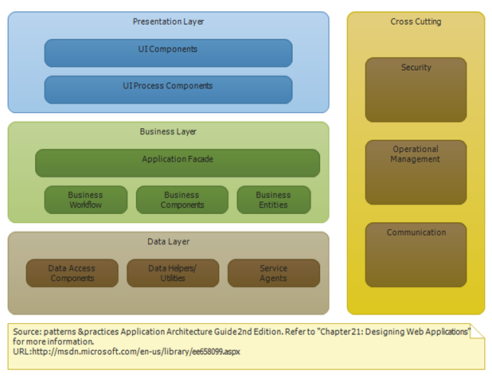
Web App – Overall Design
Following the standard web application layered construction
UI Layer
Holds all UI components
Where user interacts
Service layer
Business logic
Data Access layer
Makes calls to DB
Additional Security layer
Notes:
Jacob

Slide 58
Web App - Communication
Communication with outlet modules will all happen with Python scripts
Using built-in I2C library on Pi to communicate with PLC
Sending from web app
Java code will call Python script (Jython)
Receiving
Python scripts will be listening for I2C communication
Scripts to convert and store measurement data independently of the web application

Slide 59
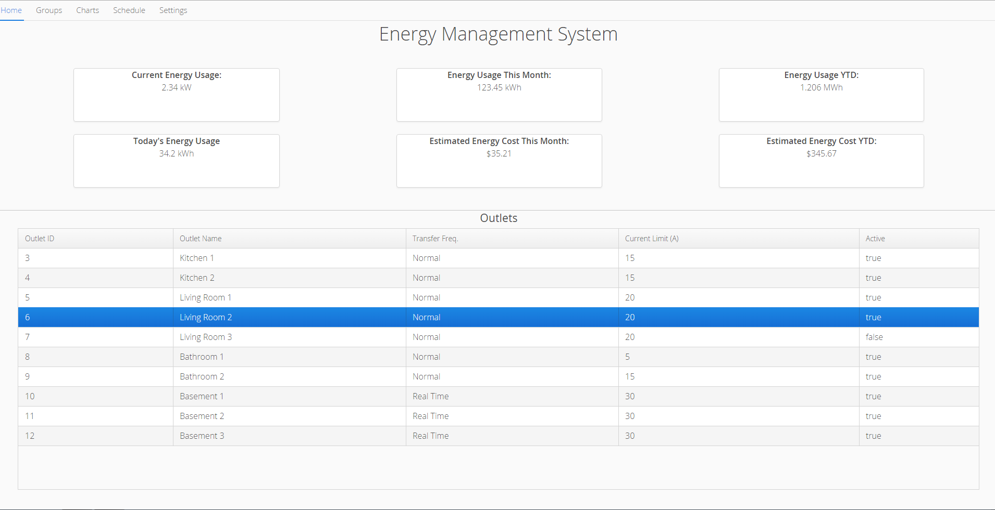
Web App - User Interface Design

Slide 60
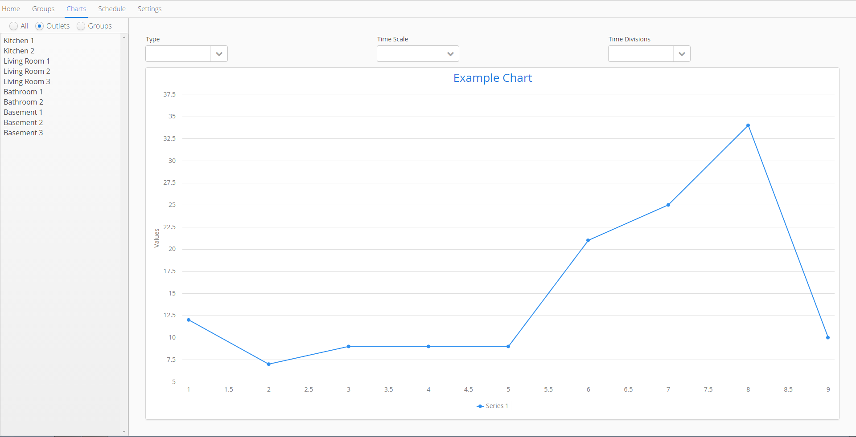
Web App - User Interface Design

Slide 61
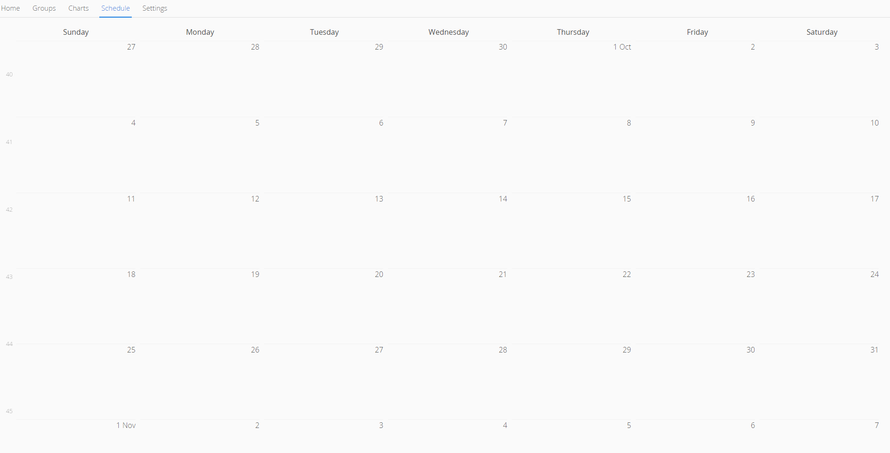
Web App - User Interface Design

Slide 62
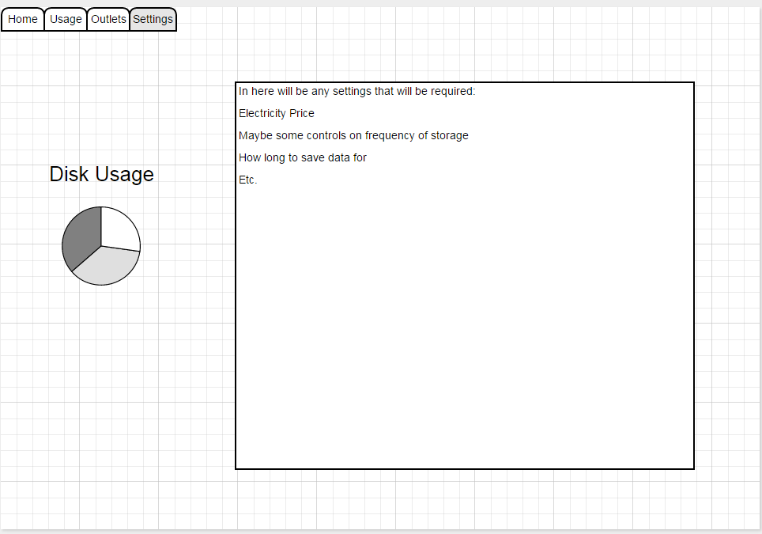
Web App - User Interface Design
Groups and Settings tab not yet constructed
Idea of Settings tab is shown here ->

Slide 63
Bill of Materials
Notes:
Jacob

Slide 64
Risks
Until we have a second operational PLC, we have no way to verify operation
Need to very quickly find a replacement or to fix the board.
Get familiar with development in the mean time to reduce development time once we have 2.
Interfacing PLC system with rest of the system
Year 2038 problem
TIMESTAMP is 32-bit integer, can only go until January 19th 2038
DATETIME is 64-bit integer, can represent up to December 31st 9999
Storing Non-real-time measurements along with real-time measurements
Real time measurements are flagged and deleted after session
Notes:
Ryan then Donald then andrew

Slide 65
Risks
Raspberry Pi
Enough memory to host both database and web app
CPU performance
Refreshing the UI
Vaadin is an event-driven framework meaning it needs events to request a repaint of the screen
Might need to “hack in” a refreshing component
Vaadin Charts library
Notes:
jacob

Slide 66
Testing
Test Type | Test Name | Engineering Requirements
Unit Tests | Power Supply DC Output Voltage | E,F
 | Voltage Sense Output Voltage | F
 | Voltage Sense Output Frequency Response | F
 | Voltage Sense Power Supply Draw | K
 | Current Sense Power Supply Draw | K
 | Load Switch Switching Current Monitor | E
 | Load Switch Switching Control Voltage Monitor | E
 | Load Switch Temperature | I,K
 | Web Application Sign In | G
 | Web Application Viewing Charts | G
 | Web App - Naming Outlets | G,L
 | Web App - Grouping Outlets | L
 | Web App - Scheduling Interface | G
 | Web App - Scheduling Job | G
Notes:
donald

Slide 67
Testing
Test Type | Test Name | Engineering Requirements
Unit Tests | Web App - Toggle outlet state | E,L
 | Web App – Settings | H
 | Load Test | G
 | Insert Outlet Module Data | L
 | Insert Outlet Reading Data | G
 | Compression of Data | G,H
Integration Tests | Voltage Sense With Controller | F
 | Current Sense With Controller | F
 | Load Switch With Controller | E
 | PCB Testing | I
 | Receive Database Information | G
 | Send Database Information | G
 | Requesting Real-Time Readings | G,H
Notes:
donald

Slide 68
Testing
Test Type | Test Name | Engineering Requirements
Acceptance Tests | Module Costs | A
 | Short Installation Time | B
 | Power Measurement Accuracy Test | F
 | Usability Test | H
 | Outlet Module Sizing | J
 | Load Testing | G
 | Schedule testing | M
 | Remote Tests | G
 | High Pot Testing | D
 | Power Line Transient Survival | C
Notes:
donald

Slide 69
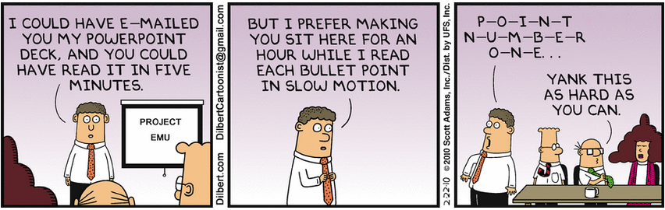
Thanks!
Questions?

